Slide 1
CS101 Algorithms and Data Structures
Graph traversal
Textbook Ch 22.2/3/5
Notes:
Adapted from the slides by Douglas Wilhelm Harder of U Waterloo (https://ece.uwaterloo.ca/~dwharder/aads/Lecture_materials/)
May also contain material from the slides at https://courses.cs.washington.edu/courses/cse326/03wi/326lecturesb.shtml (by Dan Suciu of U Washington)

Slide 2
Outline
Graph traversal
Breadth-first
Depth-first
Applications
Connectedness
Unweighted path length
Identifying bipartite graphs

Slide 3
Graph Traversal
Traversals of a graph
A means of visiting all the vertices in a graph
Also called searches
Similar to tree traversal, we have breadth-first and depth-first traversals on graphs
Breadth-first requires a queue
Depth-first requires a stack

Slide 4
Graph Traversal
Different from tree traversal: there may be multiple paths between two vertices.
To avoid visiting a vertex for multiple times, we have to track which vertices have already been visited
We may have an indicator variable in each vertex
We may use a hash table or a bit array
Requiring Θ(|V|) memory
The time complexity of graph traversal cannot be better than and should not be worse than Θ(|V| + |E|)
Connected graphs simplify this to Θ(|E|)
Worst case: Θ(|V| ²⁾

Slide 5
Breadth-first traversal
Breadth-first traversal on a graph:
Choose any vertex, mark it as visited and push it onto queue
While the queue is not empty:
Pop the top vertex v from the queue
For each vertex adjacent to v that has not been visited:
Mark it visited, and
Push it onto the queue
This continues until the queue is empty
If there are no unvisited vertices, the graph is connected
The size of the queue is O(|V|)

Slide 6
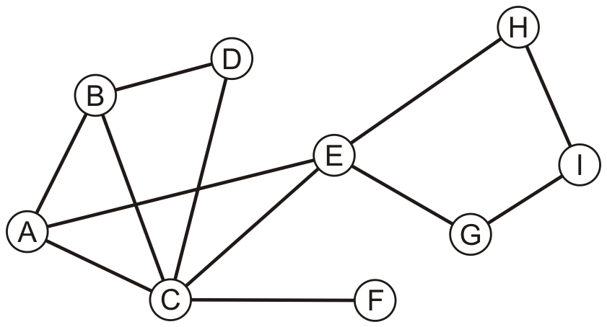
Example
Consider this graph

Slide 7
Example
Performing a breadth-first traversal
Push the first vertex onto the queue
A

Slide 8
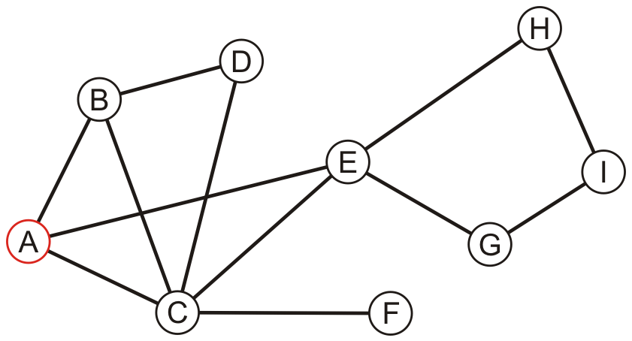
Example
Performing a breadth-first traversal
Pop A and push B, C and E
A
B | C | E

Slide 9
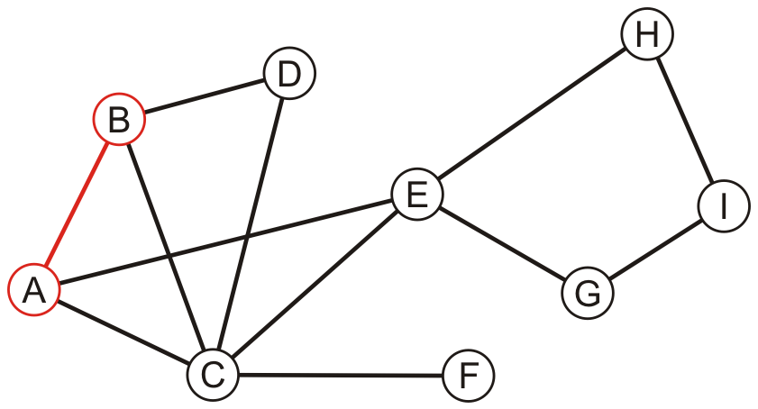
Example
Performing a breadth-first traversal:
Pop B and push D
A, B
C | E | D

Slide 10
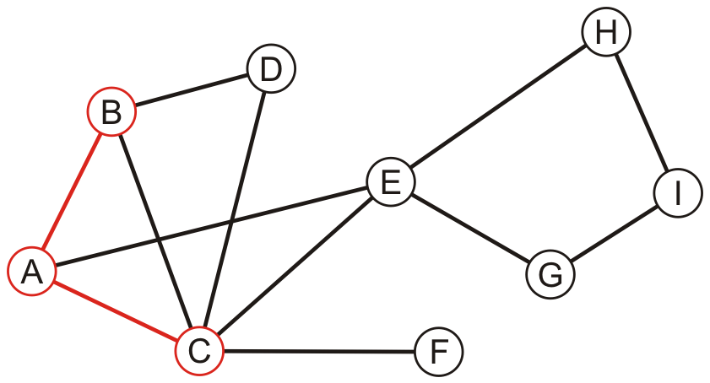
Example
Performing a breadth-first traversal:
Pop C and push F
A, B, C
E | D | F

Slide 11
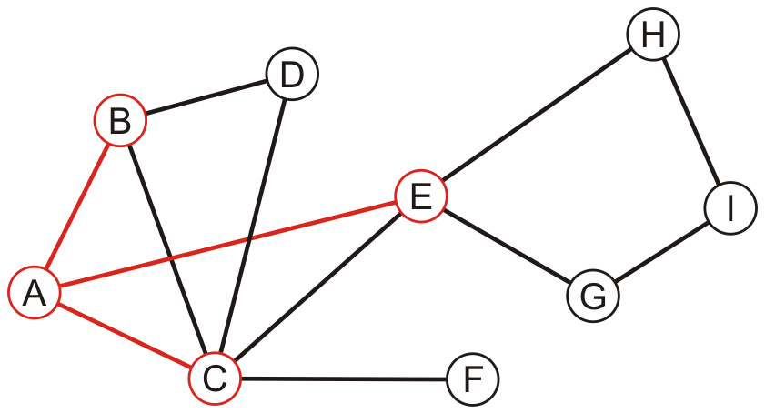
Example
Performing a breadth-first traversal:
Pop E and push G and H
A, B, C, E
D | F | G | H

Slide 12
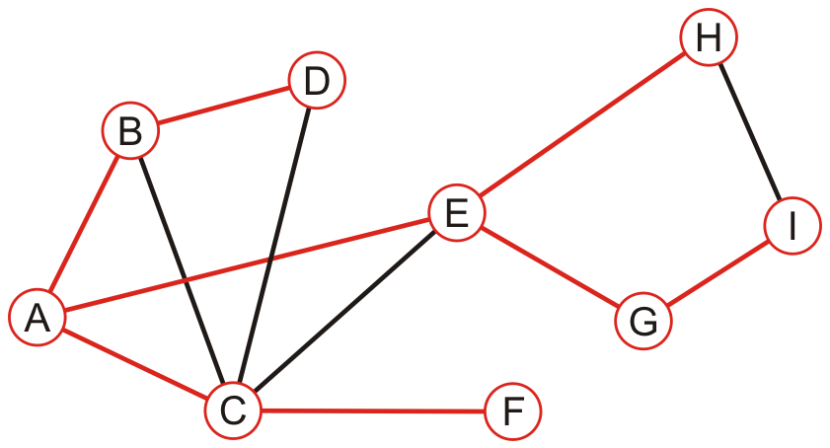
Example
Performing a breadth-first traversal:
The queue is empty: we are finished
A, B, C, E, D, F, G, H, I

Slide 13
Iterative breadth-first traversal
An implementation can use a queue
void Graph::depth_first_traversal( Vertex *first ) const {
unordered_map<Vertex *, int> hash;
hash.insert( first );
std::queue<Vertex *> queue;
queue.push( first );
while ( !queue.empty() ) {
Vertex *v = queue.front();
queue.pop();
// Perform an operation on v
for ( Vertex *w : v->adjacent_vertices() ) {
if ( !hash.member( w ) ) {
hash.insert( w );
queue.push( w );
}
}
}
}

Slide 14
Depth-first traversal
Depth-first traversal on a graph:
Choose any vertex, mark it as visited
From that vertex:
If there is another adjacent vertex not yet visited, go to it
Otherwise, go back to the previous vertex
Continue until no visited vertices have unvisited adjacent vertices
Two implementations:
Recursive
Use a stack

Slide 15
Depth-first traversal
A recursive implementation:
void Vertex::depth_first_traversal() const {
for ( Vertex *v : adjacent_vertices() ) {
if ( !v->visited() ) {
v->mark_visited();
v->depth_first_traversal();
}
}
}

Slide 16
Depth-first traversal
Use a stack:
Choose any vertex
Mark it as visited
Place it onto an empty stack
While the stack is not empty:
If the vertex on the top of the stack has an unvisited adjacent vertex v,
Mark v as visited
Place v onto the top of the stack
Otherwise, pop the top of the stack

Slide 17
Example
Perform a recursive depth-first traversal on this same graph

Slide 18
Example
Performing a recursive depth-first traversal:
Visit the first node
A

Slide 19
Example
Performing a recursive depth-first traversal:
A has an unvisited neighbor
A, B

Slide 20
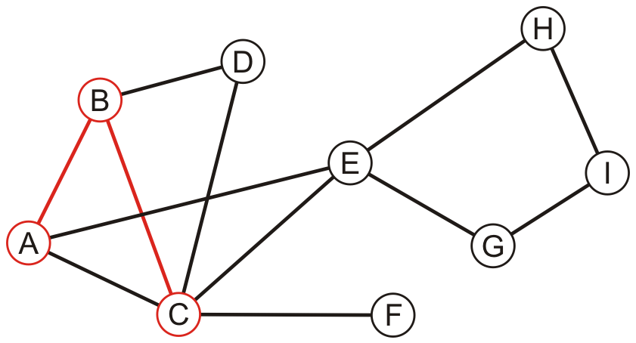
Example
Performing a recursive depth-first traversal:
B has an unvisited neighbor
A, B, C

Slide 21
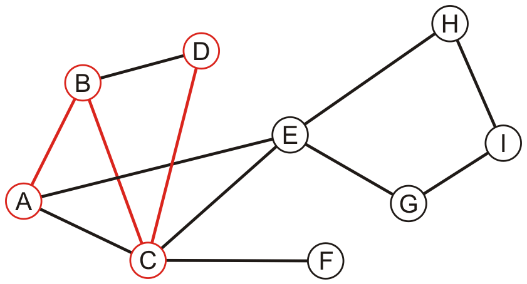
Example
Performing a recursive depth-first traversal:
C has an unvisited neighbor
A, B, C, D

Slide 22
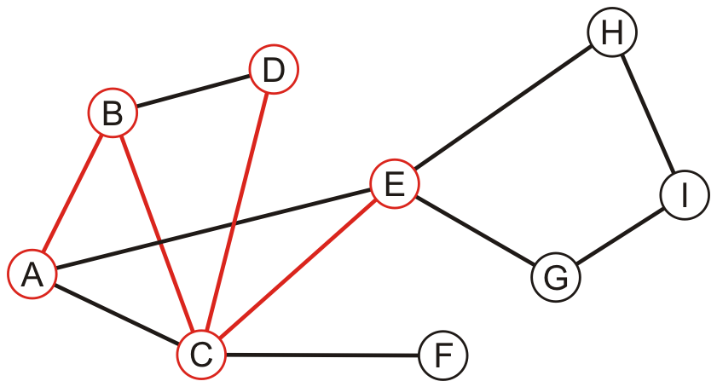
Example
Performing a recursive depth-first traversal:
D has no unvisited neighbors, so we return to C
A, B, C, D, E

Slide 23
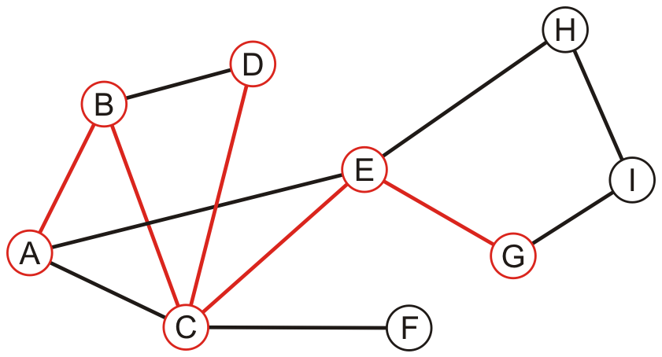
Example
Performing a recursive depth-first traversal:
E has an unvisited neighbor
A, B, C, D, E, G

Slide 24
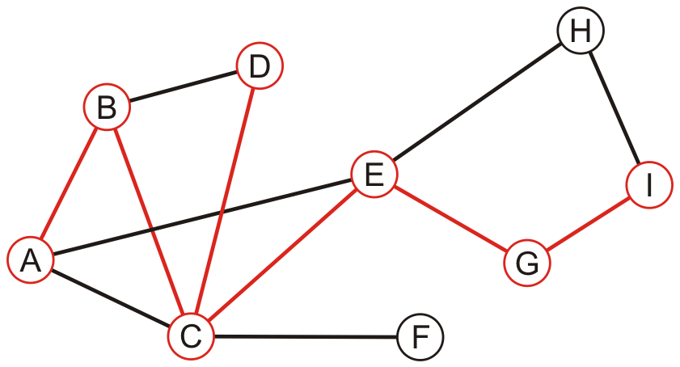
Example
Performing a recursive depth-first traversal:
F has an unvisited neighbor
A, B, C, D, E, G, I

Slide 25
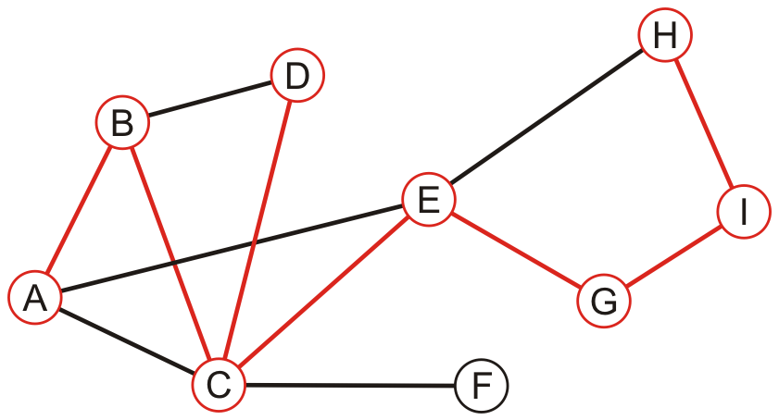
Example
Performing a recursive depth-first traversal:
H has an unvisited neighbor
A, B, C, D, E, G, I, H

Slide 26
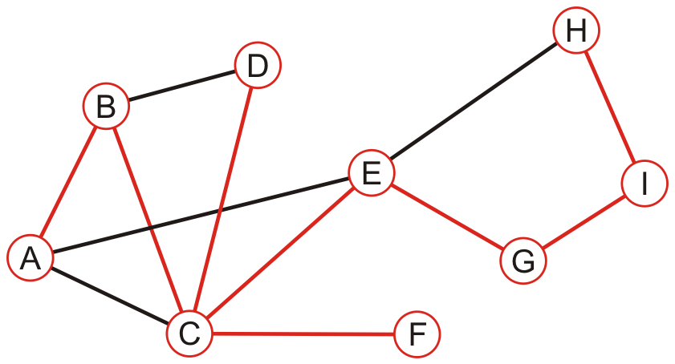
Example
Performing a recursive depth-first traversal:
We recurse back to C which has an unvisited neighbour
A, B, C, D, E, G, I, H, F

Slide 27
Example
Performing a recursive depth-first traversal:
We recurse finding that no other nodes have unvisited neighbours
A, B, C, D, E, G, I, H, F

Slide 28
Comparison
The order in which vertices can differ greatly
An iterative depth-first traversal may also be different again
A, B, C, E, D, F, G, H, I
A, B, C, D, E, G, I, H, F

Slide 29
Outline
Graph traversal
Breadth-first
Depth-first
Applications
Connectedness
Unweighted path length
Identifying bipartite graphs

Slide 30
Connected
First, let us determine whether one vertex is connected to another
v_{j} is connected to v_{k} if there is a path from the first to the second
Strategy:
Perform a breadth-first traversal starting at v_{j}
If the vertex v_{k} is ever found during the traversal, return true
Otherwise, return false

Slide 31
Connected
Consider implementing a breadth-first traversal on an undirected graph:
Choose any vertex, mark it as visited and push it onto queue
While the queue is not empty:
Pop to top vertex v from the queue
For each vertex adjacent to v that has not been visited:
Mark it visited, and
Push it onto the queue
This continues until the queue is empty
Note: if there are no unvisited vertices, the graph is connected,

Slide 32
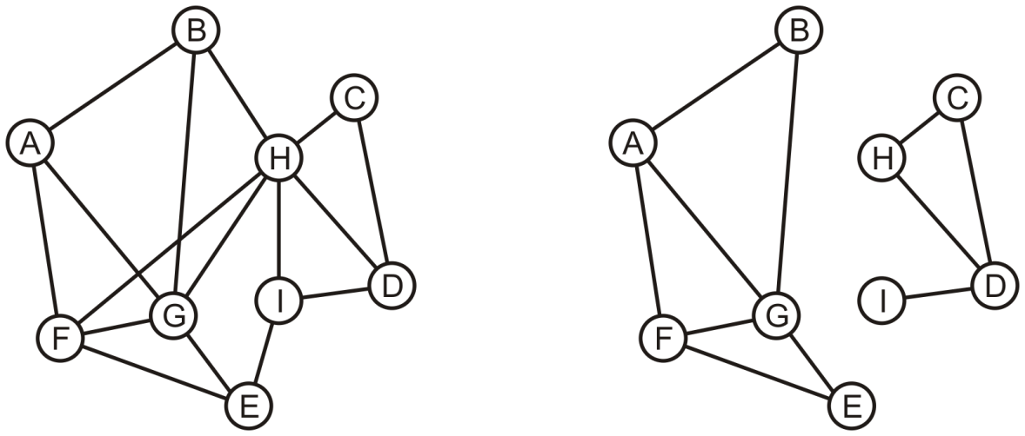
Determining Connections
Is A connected to D?

Slide 33
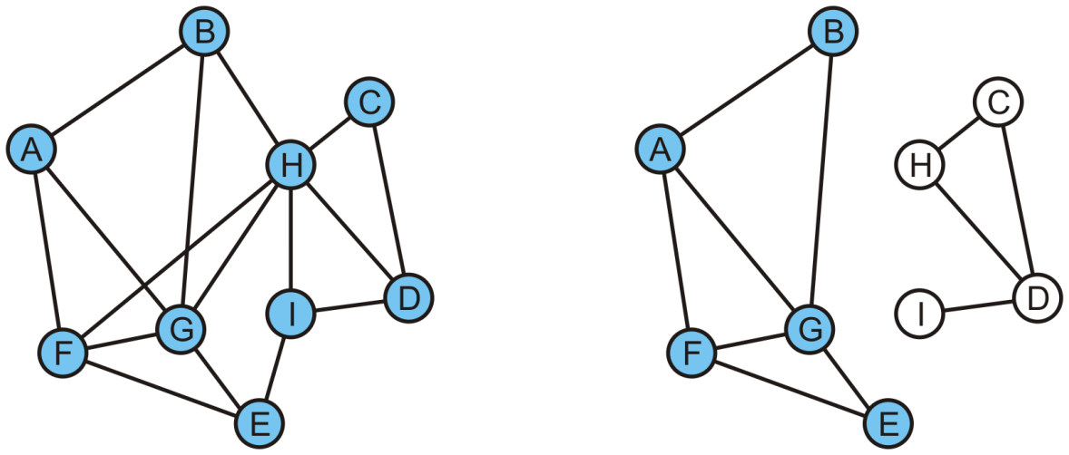
Determining Connections
On the right, the queue is empty and D is not visited
We determine A is not connected to D
C | I | D

Slide 34
Connected Components
Suppose we want to partition the vertices into connected sub-graphs
While there are unvisited vertices in the tree:
Select an unvisited vertex and perform a traversal on that vertex
Each vertex that is visited in that traversal is added to the set initially containing the initial unvisited vertex
Continue until all vertices are visited
We would use a disjoint set data structure for maximum efficiency

Slide 35
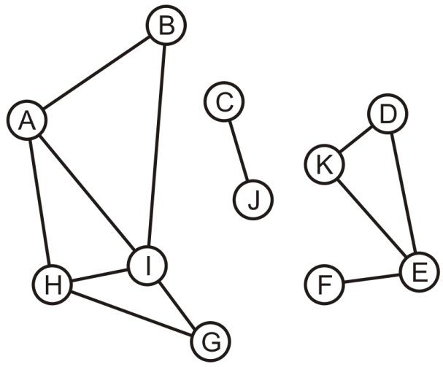
Connected Components
Here we start with a set of singletons
A | B | C | D | E | F | G | H | I | J | K
A | B | C | D | E | F | G | H | I | J | K

Slide 36
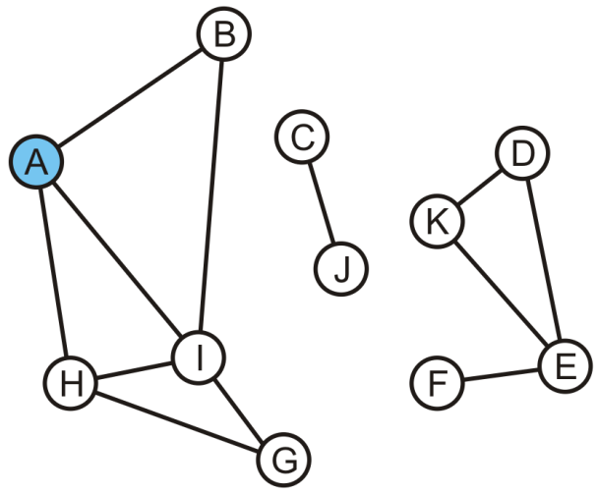
Connected Components
The vertex A is unvisited, so we start with it
A | B | C | D | E | F | G | H | I | J | K
A | B | C | D | E | F | G | H | I | J | K

Slide 37
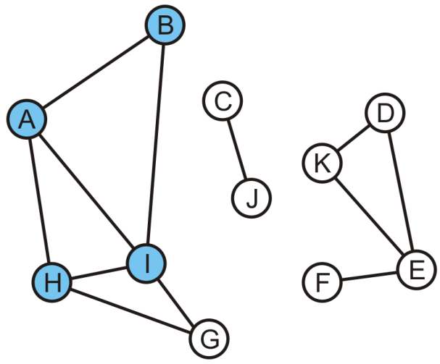
Connected Components
Take the union of with its adjacent vertices: {A, B, H, I}
A | B | C | D | E | F | G | H | I | J | K
A | A | C | D | E | F | G | A | A | J | K

Slide 38
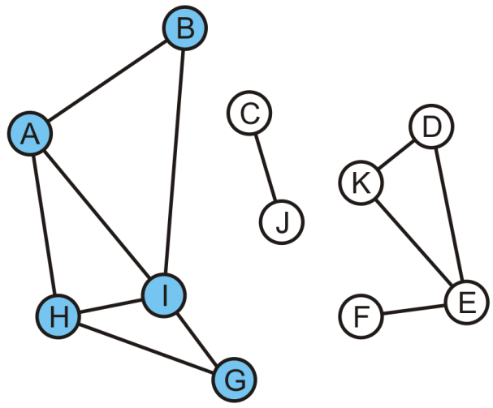
Connected Components
As the traversal continues, we take the union of the set {G} with the set containing H: {A, B, G, H, I}
The traversal is finished
A | B | C | D | E | F | G | H | I | J | K
A | A | C | D | E | F | A | A | A | J | K

Slide 39
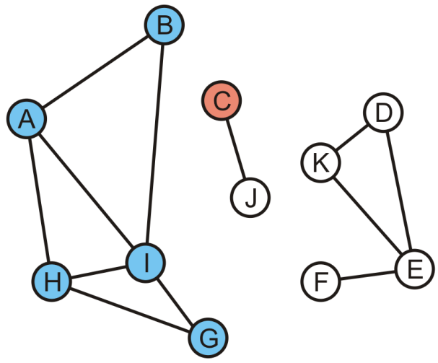
Connected Components
Start another traversal with C: this defines a new set {C}
A | B | C | D | E | F | G | H | I | J | K
A | A | C | D | E | F | A | A | A | J | K

Slide 40
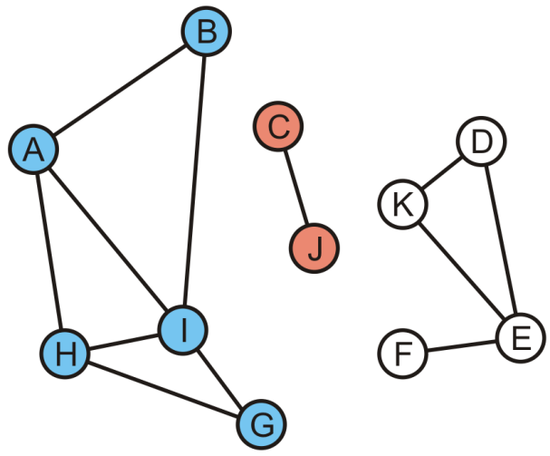
Connected Components
We take the union of {C} and its adjacent vertex J: {C, J}
This traversal is finished
A | B | C | D | E | F | G | H | I | J | K
A | A | C | D | E | F | A | A | A | C | K

Slide 41
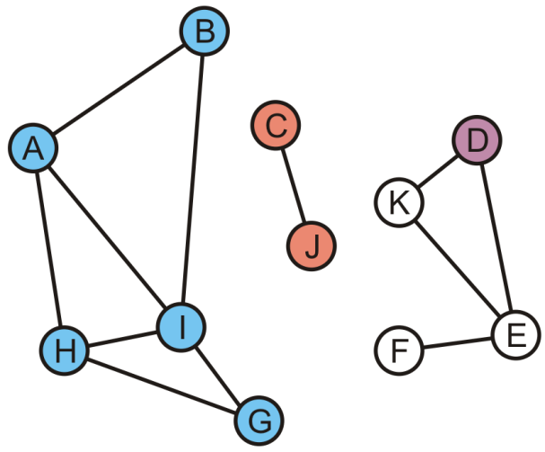
Connected Components
We start again with the set {D}
A | B | C | D | E | F | G | H | I | J | K
A | A | C | D | E | F | A | A | A | C | K

Slide 42
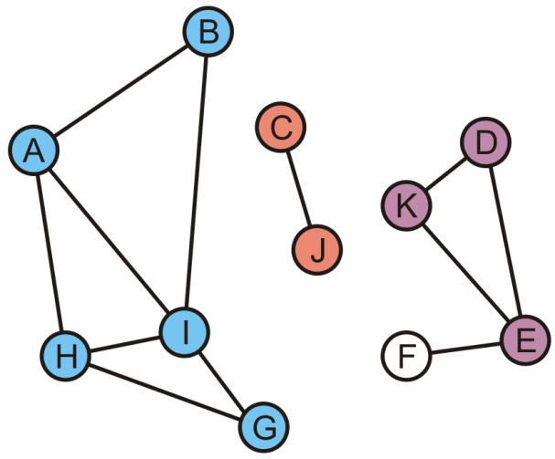
Connected Components
K and E are adjacent to D, so take the unions creating {D, E, K}
A | B | C | D | E | F | G | H | I | J | K
A | A | C | D | D | F | A | A | A | C | D

Slide 43
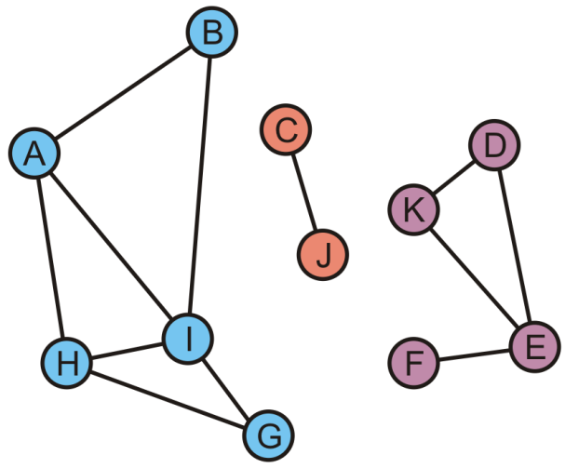
Connected Components
Finally, during this last traversal we find that F is adjacent to E
Take the union of {F} with the set containing E: {D, E, F, K}
A | B | C | D | E | F | G | H | I | J | K
A | A | C | D | D | D | A | A | A | C | D

Slide 44
Connected Components
All vertices are visited, so we are done
There are three connected sub-graphs {A, B, G, H, I}, {C, J}, {D, E, F, K}
A | B | C | D | E | F | G | H | I | J | K
A | A | C | D | D | D | A | A | A | C | D

Slide 45
Tracking Unvisited Vertices
How do you implement a set of unvisited vertices so as to:
Find an unvisited vertex in Θ(1) time?
Remove a vertex that has been visited from this list in Θ(1) time?
Bad solution
We can simply flag vertices as visited, but this would require O(|V|) time to find an unvisited vertex
Good solutions
A hash table of unvisited vertices
Or, an array of unvisited vertices, and we store for each vertex its position in the array
Notes:
The solution will have to use Θ(|V|) additional memory…

Slide 46
Tracking Unvisited Vertices
Create two arrays:
One array, unvisited, will contain the unvisited vertices
The other, loc_in_unvisited, will contain the location of vertex v_{i} in the first array
Or, instead of a second array, we may add a member variable in the vertex class
0 | 1 | 2 | 3 | 4 | 5 | 6 | 7 | 8 | 9 | 10
A | B | C | D | E | F | G | H | I | J | K
A | B | C | D | E | F | G | H | I | J | K
0 | 1 | 2 | 3 | 4 | 5 | 6 | 7 | 8 | 9 | 10

Slide 47
Tracking Unvisited Vertices
Suppose we visit D
D is in entry 3
How shall we delete D in the first array?
0 | 1 | 2 | 3 | 4 | 5 | 6 | 7 | 8 | 9 | 10
A | B | C | D | E | F | G | H | I | J | K
A | B | C | D | E | F | G | H | I | J | K
0 | 1 | 2 | 3 | 4 | 5 | 6 | 7 | 8 | 9 | 10

Slide 48
Tracking Unvisited Vertices
Suppose we visit D
D is in entry 3
Copy the last unvisited vertex into this location and update the location array for this value
0 | 1 | 2 | 3 | 4 | 5 | 6 | 7 | 8 | 9 | 10
A | B | C | K | E | F | G | H | I | J
A | B | C | D | E | F | G | H | I | J | K
0 | 1 | 2 | 3 | 4 | 5 | 6 | 7 | 8 | 9 | 3

Slide 49
Tracking Unvisited Vertices
Suppose we visit G
G is in entry 6
0 | 1 | 2 | 3 | 4 | 5 | 6 | 7 | 8 | 9 | 10
A | B | C | K | E | F | G | H | I | J
A | B | C | D | E | F | G | H | I | J | K
0 | 1 | 2 | 3 | 4 | 5 | 6 | 7 | 8 | 9 | 3

Slide 50
Tracking Unvisited Vertices
Suppose we visit G
G is in entry 6
Copy the last unvisited vertex into this location and update the location array for this value
0 | 1 | 2 | 3 | 4 | 5 | 6 | 7 | 8 | 9 | 10
A | B | C | K | E | F | J | H | I
A | B | C | D | E | F | G | H | I | J | K
0 | 1 | 2 | 3 | 4 | 5 | 6 | 7 | 8 | 6 | 3

Slide 51
Tracking Unvisited Vertices
Suppose we now visit K
K is in entry 3
0 | 1 | 2 | 3 | 4 | 5 | 6 | 7 | 8 | 9 | 10
A | B | C | K | E | F | J | H | I
A | B | C | D | E | F | G | H | I | J | K
0 | 1 | 2 | 3 | 4 | 5 | 6 | 7 | 8 | 6 | 3

Slide 52
Tracking Unvisited Vertices
Suppose we now visit K
K is in entry 3
Copy the last unvisited vertex into this location and update the location array for this value
0 | 1 | 2 | 3 | 4 | 5 | 6 | 7 | 8 | 9 | 10
A | B | C | I | E | F | J | H
A | B | C | D | E | F | G | H | I | J | K
0 | 1 | 2 | 3 | 4 | 5 | 6 | 7 | 3 | 6 | 3

Slide 53
Tracking Unvisited Vertices
If we want to find an unvisited vertex, we simply return the last entry of the first array and return it
0 | 1 | 2 | 3 | 4 | 5 | 6 | 7 | 8 | 9 | 10
A | B | C | I | E | F | J | H
A | B | C | D | E | F | G | H | I | J | K
0 | 1 | 2 | 3 | 4 | 5 | 6 | 7 | 3 | 6 | 3

Slide 54
Tracking Unvisited Vertices
In this case, an unvisited vertex is H
Removing it is trivial: just decrement the count of unvisited vertices
0 | 1 | 2 | 3 | 4 | 5 | 6 | 7 | 8 | 9 | 10
A | B | C | I | E | F | J
A | B | C | D | E | F | G | H | I | J | K
0 | 1 | 2 | 3 | 4 | 5 | 6 | 7 | 3 | 6 | 3

Slide 55
Outline
Graph traversal
Breadth-first
Depth-first
Applications
Connectedness
Unweighted path length
Identifying bipartite graphs

Slide 56
Determining Distances
Problem: in an unweighted graph, find the distances from one vertex v to all the other vertices
Distance: the length of the shortest path between two vertices
Method:
Use a breadth-first traversal
Vertices are added in layers
The starting vertex v is defined to be in the zeroth layer, L₀
While the k^{th} layer is not empty, all unvisited vertices adjacent to vertices in L_{k} are added to the (k + 1)^{st} layer
The distance from v to vertices in L_{k} is k
Any unvisited vertices are said to have an infinite distance from v
Notes:
Reference: Kleinberg and Tardos

Slide 57
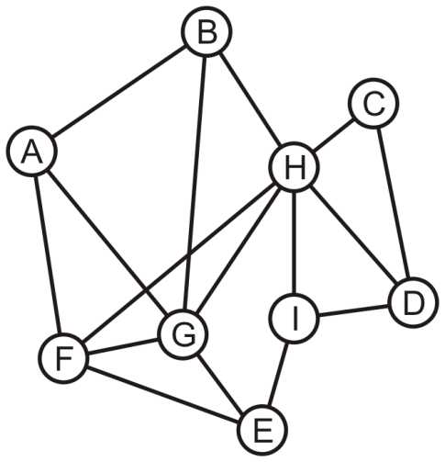
Determining Distances
Consider this graph: find the distance from A to each other vertex

Slide 58
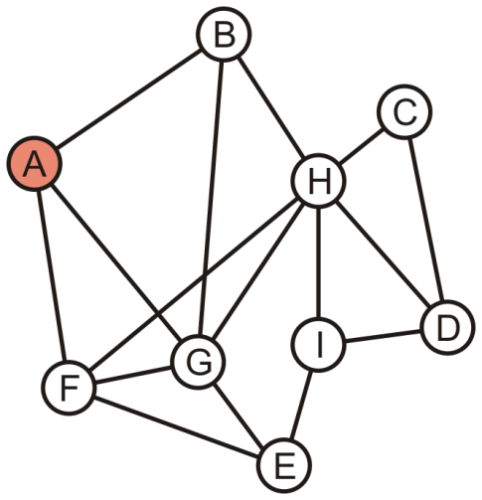
Determining Distances
A forms the zeroeth layer, L₀
A

Slide 59
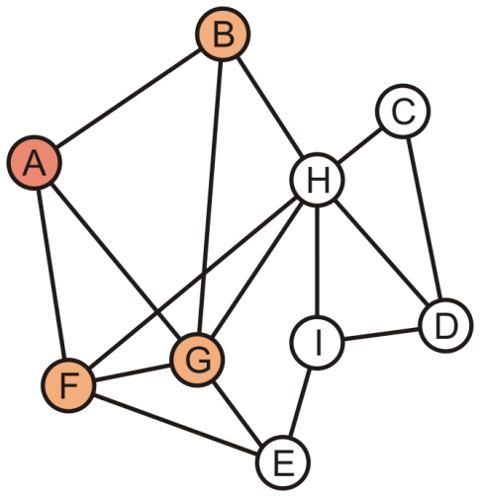
Determining Distances
The unvisited vertices B, F and G are adjacent to A
These form the first layer, L₁
B | F | G

Slide 60
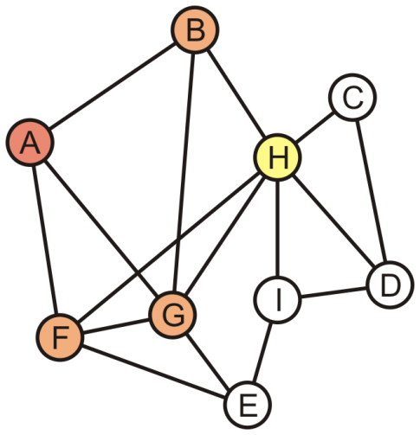
Determining Distances
We now begin popping L₁ vertices: pop B
H is adjacent to B
It is tagged L₂
F | G | H

Slide 61
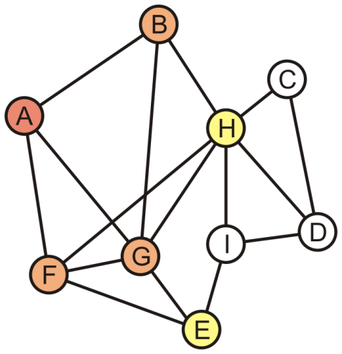
Determining Distances
Popping F pushes E onto the queue
It is also tagged L₂
G | H | E

Slide 62
Determining Distances
We pop G which has no other unvisited neighbours
G is the last L₁ vertex; thus H and E form the second layer, L₂
H | E

Slide 63
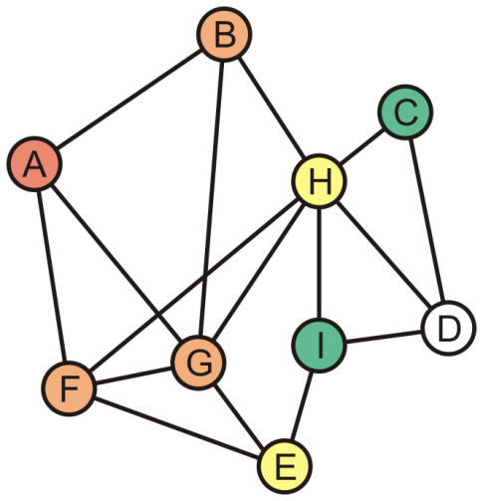
Determining Distances
Popping H in L₂ adds C and I to the third layer L₃
E | C | I

Slide 64
Determining Distances
E has no more adjacent unvisited vertices
Thus C and I form the third layer, L₃
C | I

Slide 65
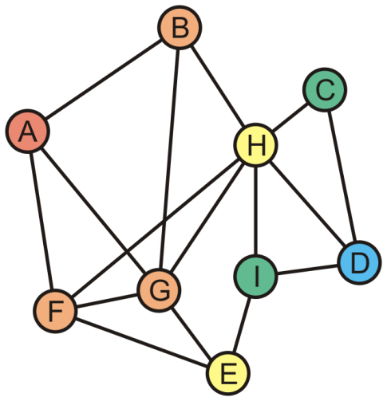
Determining Distances
The unvisited vertex D is adjacent to vertices in L₃
This vertex forms the fourth layer, L₄
Distance 1: B, F, G
Distance 2: H, E
Distance 3: C, I
Distance 4: D

Slide 66
Determining Distances
Theorem:
If, in a breadth-first traversal of a graph, two vertices v and w appear in layers L_{i} and L_{j}, respectively and {v, w} is an edge in the graph, then i and j differ by at most one
Proof:
If i = j, we are done
If i ≠ j, without loss of generality, assume i < j
Because v ∈ L_{i}, w does not appear in any previous layer, and {v, w} is an edge in the graph, it follows that w ∈ L_{i + 1}
Thus, j = i + 1
Therefore, i and j differ by at most one

Slide 67
Outline
Graph traversal
Breadth-first
Depth-first
Applications
Connectedness
Unweighted path length
Identifying bipartite graphs

Slide 68
Definition
Definition
A bipartite graph is a graph where the vertices V can be divided into two disjoint sets V₁ and V₂ such that every edge has one vertex in V₁ and the other in V₂

Slide 69
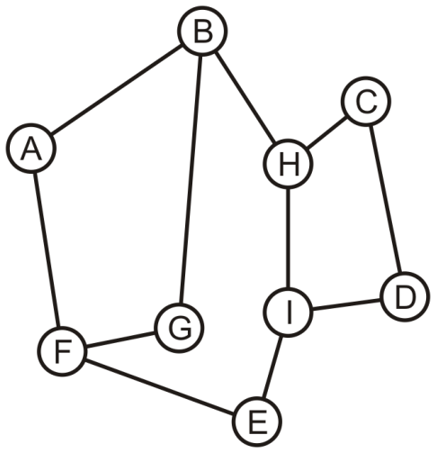
Bipartite Graphs
Consider this graph: is it bipartite?

Slide 70
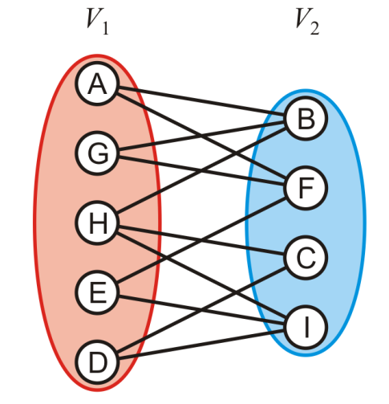
Bipartite Graphs
Yes: With a little work, it is possible to determine that we can decompose the vertices into two disjoint sets

Slide 71
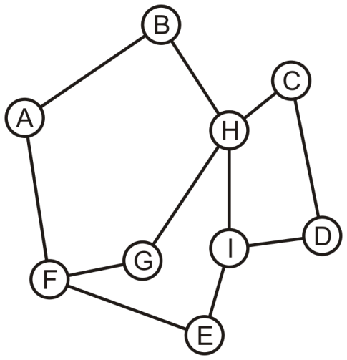
Bipartite Graphs
Is this graph bipartite?

Slide 72
Bipartite Graphs
In this case, it is not a bipartite graph
How can we determine if a graph is bipartite?

Slide 73
Bipartite Graphs
Use a breadth-first traversal for a connected graph:
Choose a vertex, mark it belonging to V₁ and push it onto a queue
While the queue is not empty, pop the front vertex v and
Any adjacent vertices that are already marked must belong to the set not containing v, otherwise, the graph is not bipartite (we are done);
Any unmarked adjacent vertices are marked as belonging to the other set and they are pushed onto the queue
If the queue is empty, the graph is bipartite

Slide 74
Bipartite Graphs
With the first graph, we can start with any vertex
We will use colours to distinguish the two sets

Slide 75
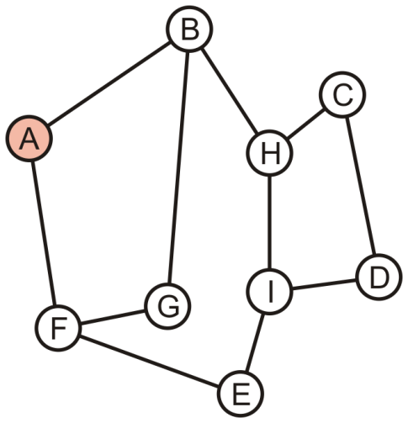
Bipartite Graphs
Push A onto the queue and colour it red
A

Slide 76
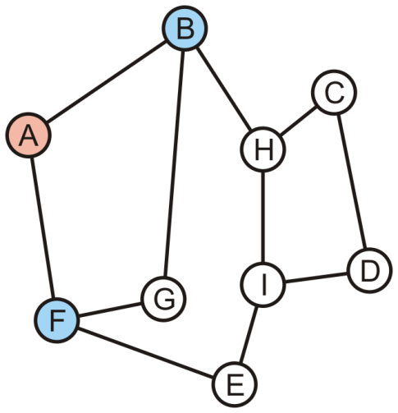
Bipartite Graphs
Pop A and its two neighbours are not marked:
Mark them as blue and push them onto the queue
B | F

Slide 77
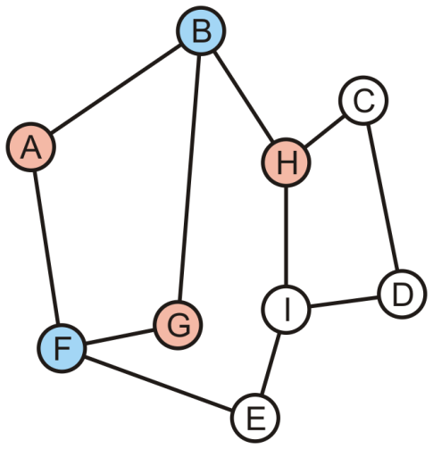
Bipartite Graphs
Pop B—it is blue:
Its one marked neighbour, A, is red
Its other neighbours G and H are not marked: mark them red and push them onto the queue
F | G | H

Slide 78
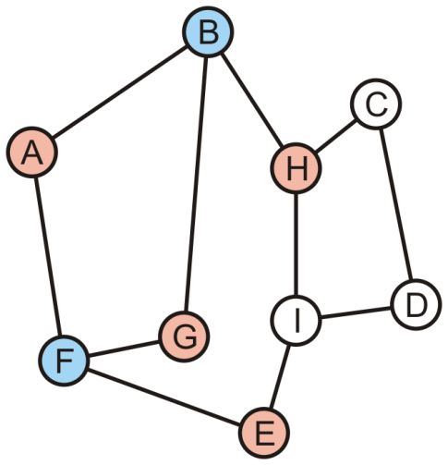
Bipartite Graphs
Pop F—it is blue:
Its two marked neighbours, A and G, are red
Its neighbour E is not marked: mark it red and pus it onto the queue
G | H | E

Slide 79
Bipartite Graphs
Pop G—it is red:
Its two marked neighbours, B and F, are blue
H | E

Slide 80
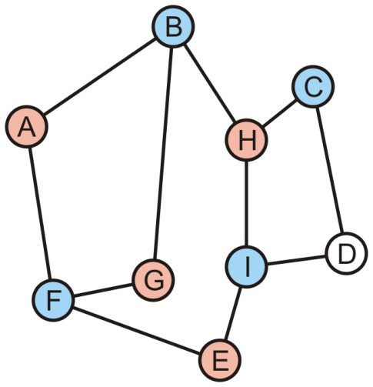
Bipartite Graphs
Pop H—it is red:
Its marked neighbours, B, is blue
It has two unmarked neighbours, C and I; mark them blue and push them onto the queue
E | C | I

Slide 81
Bipartite Graphs
Pop E—it is red:
Its marked neighbours, F and I, are blue
C | I

Slide 82
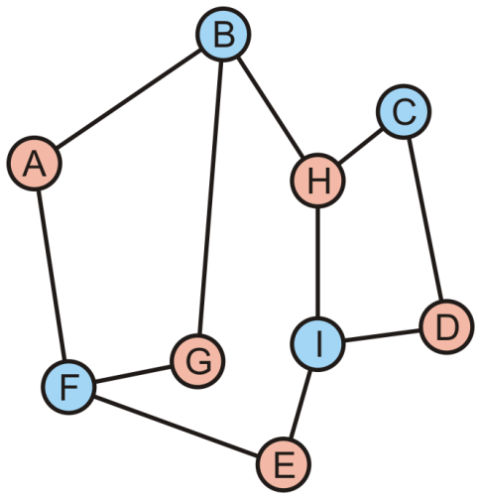
Bipartite Graphs
Pop C—it is blue:
Its marked neighbour, H, is red
Mark D as red and push it onto the queue
I | D

Slide 83
Bipartite Graphs
Pop I—it is blue:
Its marked neighbours, H, D and E, are all red
D

Slide 84
Bipartite Graphs
Pop D—it is red:
Its marked neighbours, C and I, are both blue

Slide 85
Bipartite Graphs
The queue is empty, the graph is bipartite

Slide 86
Bipartite Graphs
Consider the other graph which was claimed to be not bipartite

Slide 87
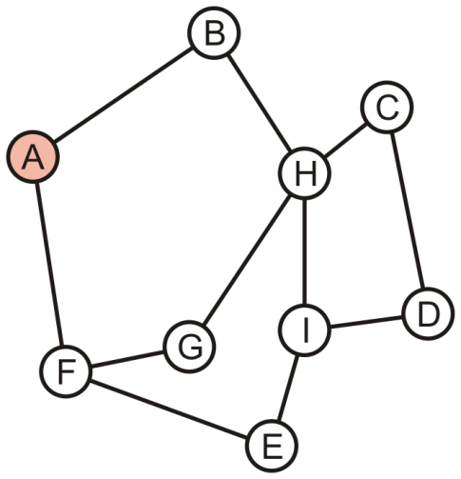
Bipartite Graphs
Push A onto the queue and colour it red
A

Slide 88
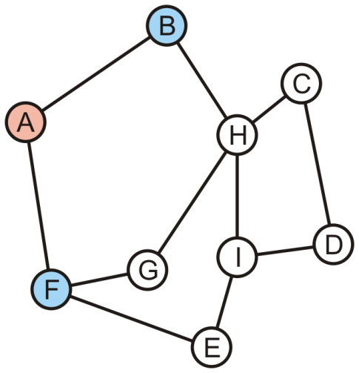
Bipartite Graphs
Pop A off the queue:
Its neighbours are unmarked: colour them blue and push them onto the queue
B | F

Slide 89
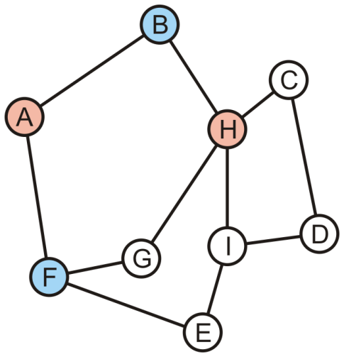
Bipartite Graphs
Pop B off the queue:
Its one neighbour, A, is red
The other neighbour, H, is unmarked: colour it red and push it onto the queue
F | H

Slide 90
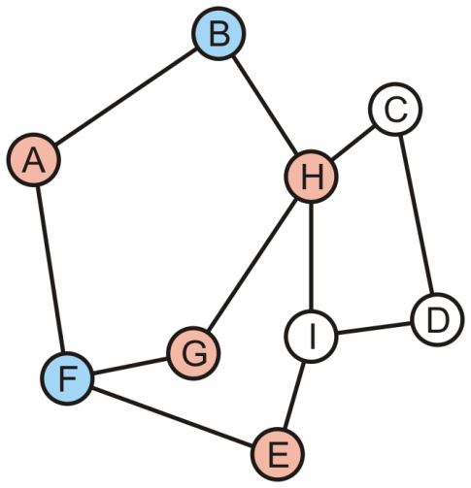
Bipartite Graphs
Pop F off the queue:
Its one neighbour, A, is red
The other neighbours, E and G, are unmarked: colour them red and push it onto the queue
H | E | G

Slide 91
Bipartite Graphs
Pop H off the queue—it is red:
Its one neighbour, G, is already red
The graph is not bipartite
E | G

Slide 92
Bipartite Graphs
Definition
Cycles that contains either an even number or an odd number of vertices are said to be even cycles and odd cycles, respectively
Theorem
A graph is bipartite if and only if it does not contain any odd cycles
Notes:
Reference: Kleinberg and Tardos

Slide 93
Outline
Graph traversal
Breadth-first: use a queue
Depth-first: use recursion or stack
Applications
Connectedness
Unweighted path length
Identifying bipartite graphs

